Slide 1
Inheritance and Polymorphism

Slide 2
Contents
Inheritance Concepts
Inheritance Examples
Implementing Inheritance in C++
Polymorphism
Dynamic Binding
Virtual Function Examples

Slide 3
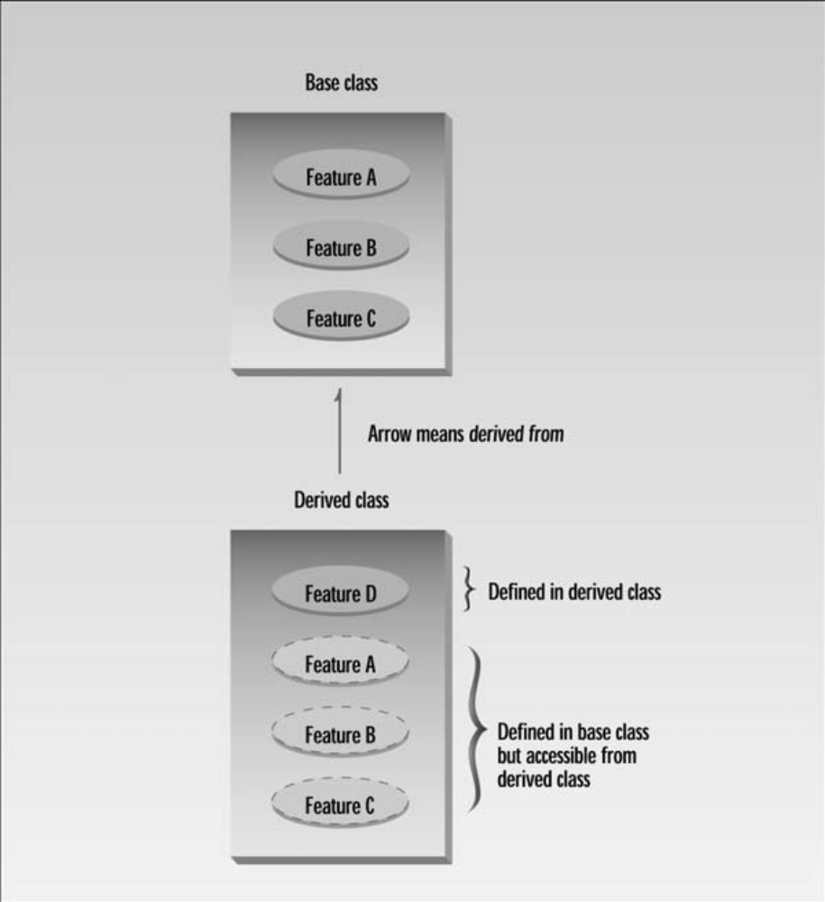

Slide 4
Inheritance Concepts
Deriving a new class (subclass) from an existing class (base class or superclass).
Inheritance creates a hierarchy of related classes which share code and interface.

Slide 5
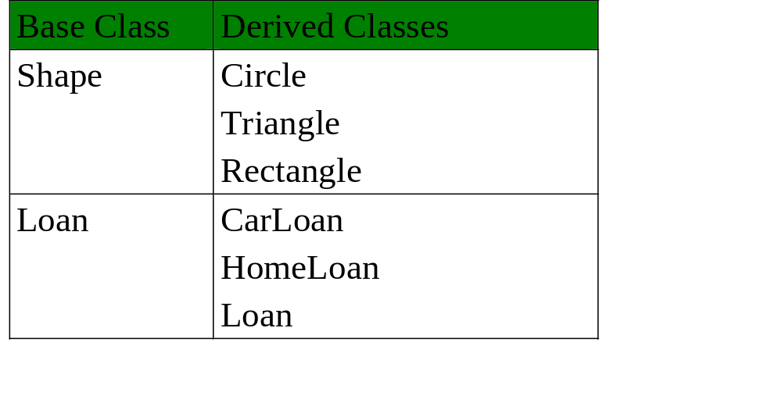
Inheritance Examples

Slide 6
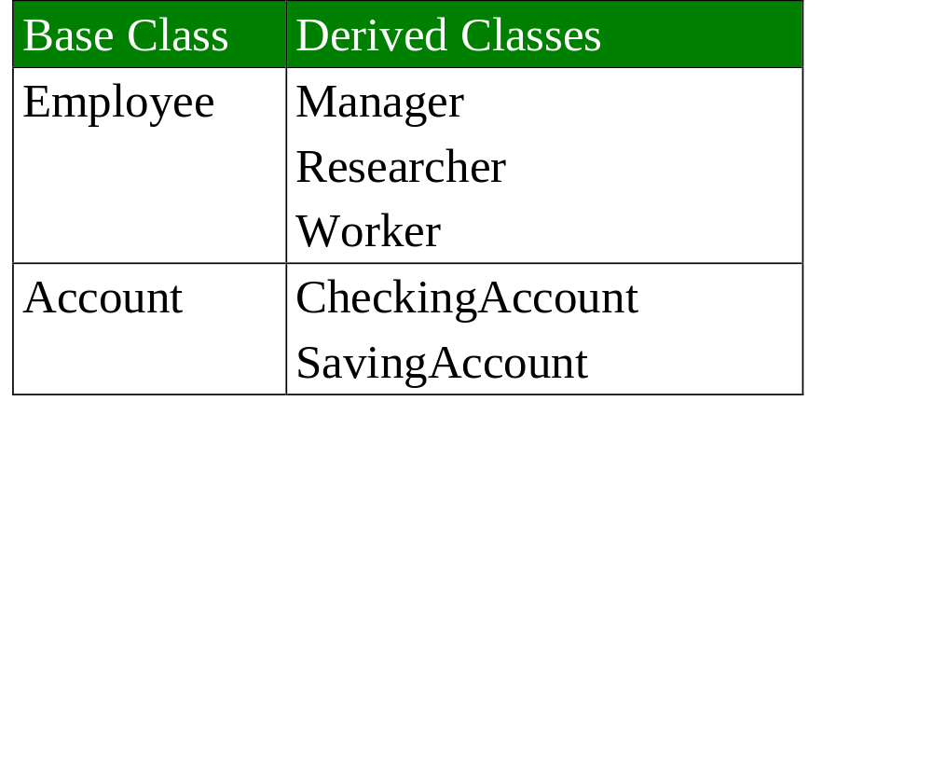
More Examples

Slide 7
Shape class hierarchy
Shape
TwoDimensionalShape
ThreeDimensionalShape
Circle
Square
Triangle
Sphere
Cube
Tetrahedron

Slide 8
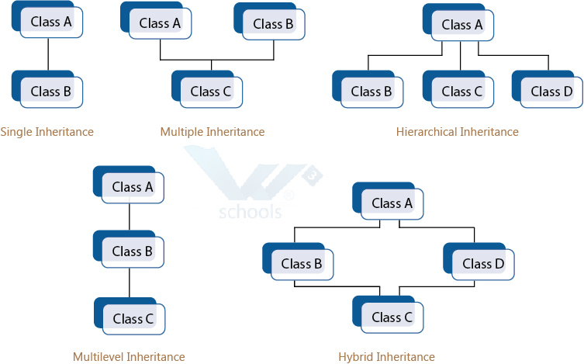

Slide 9
Implementing Inheritance in C++
Develop a base class.
Use it to define a derived class.
Syntax:
class derived_class_name : access_mode base_class_name
{
// body of class
};

Slide 10
Base class member visibility | Type of inheritance
 | public | private | protected
public | public | private | protected
private | Not inherited | Not inherited | Not inherited
protected | protected | private | protected

Slide 11
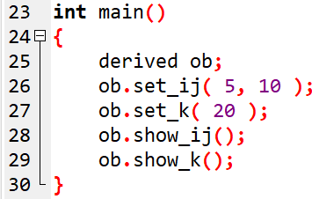
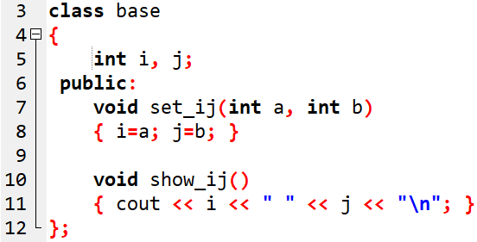
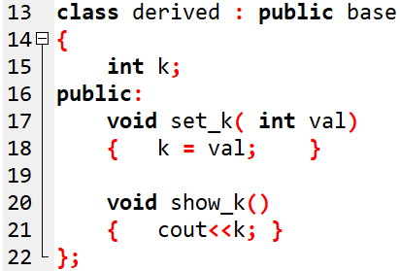

Example-1: Public Inheritance
OUTPUT:

Slide 12
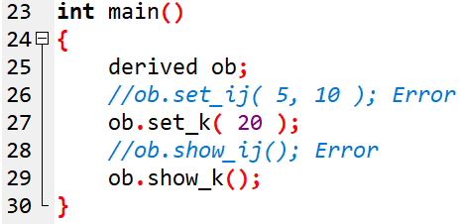
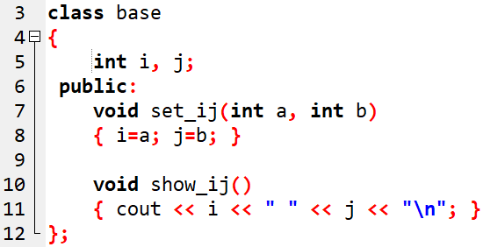
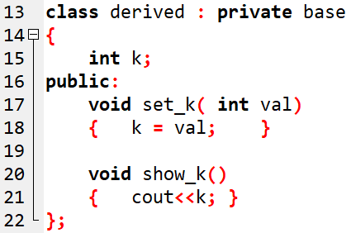
Example-2: Private Inheritance

Slide 13
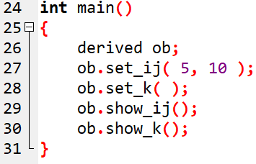
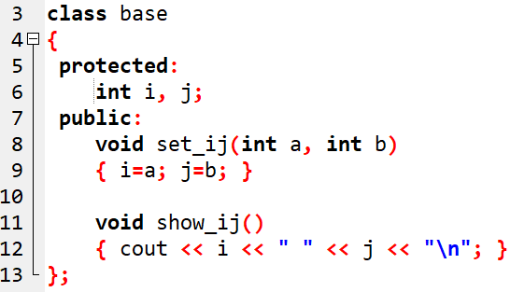
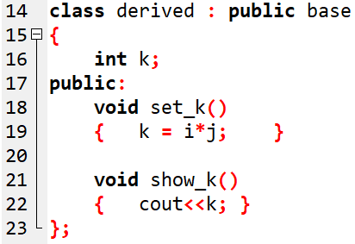

Example-3: protected members
OUTPUT:

Slide 14
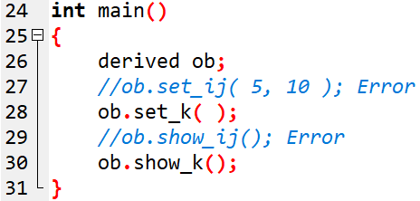
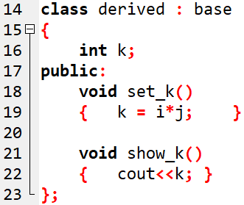
Example-4: protected members

Slide 15
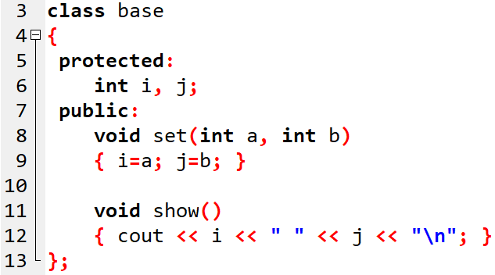
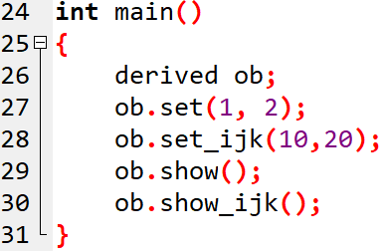
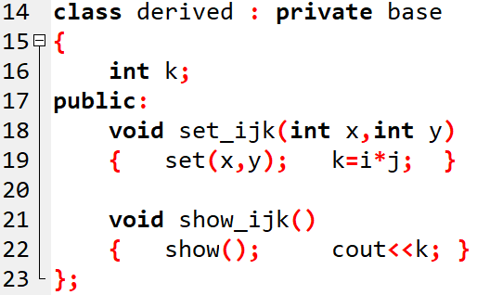
Example-4:
//Error !
//Error !

Slide 16
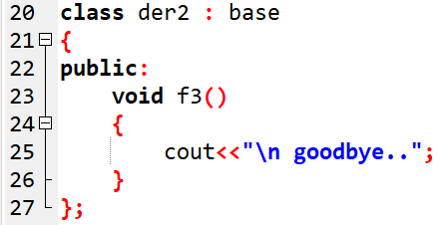
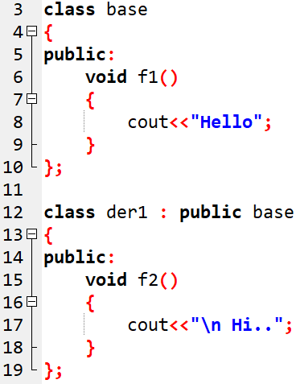
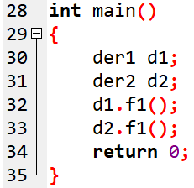
Question - 1
//Error !

Slide 17
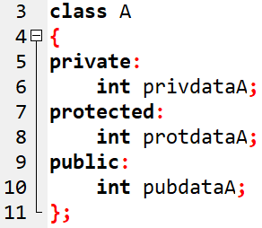
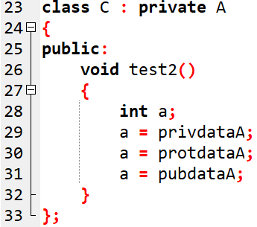

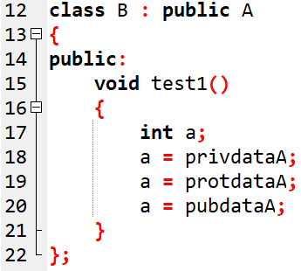
Question - 2

Slide 18
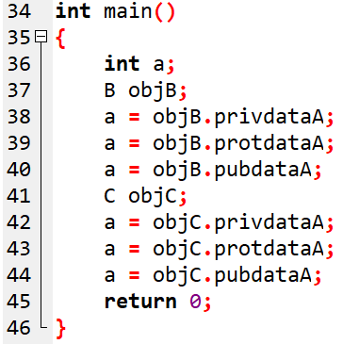
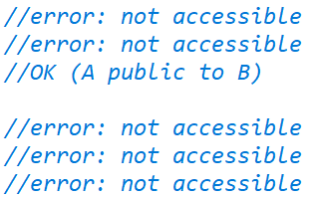

Slide 19
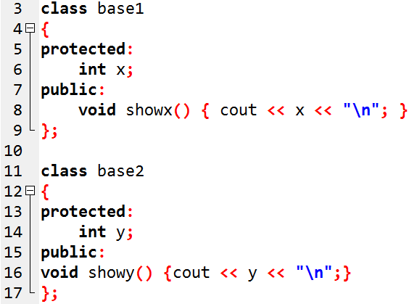
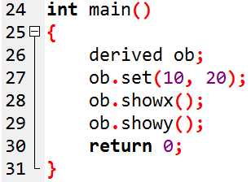
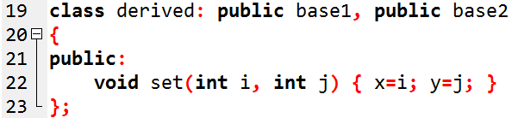
Example: Multiple inheritance

Slide 20
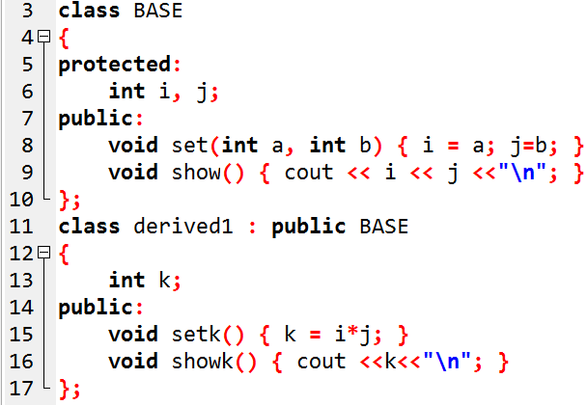

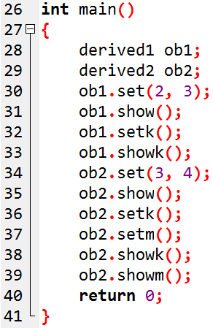
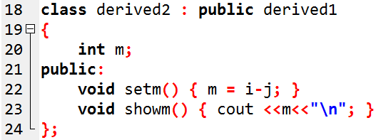
Example: Multilevel inheritance
OUTPUT:

Slide 21
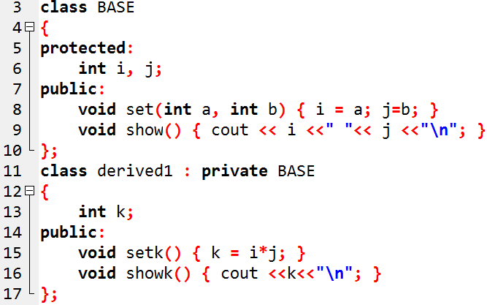
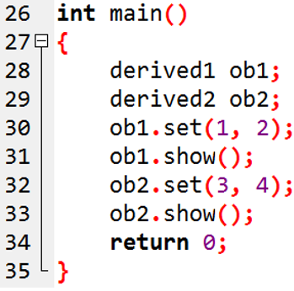

Slide 22
X
// Error

Slide 23
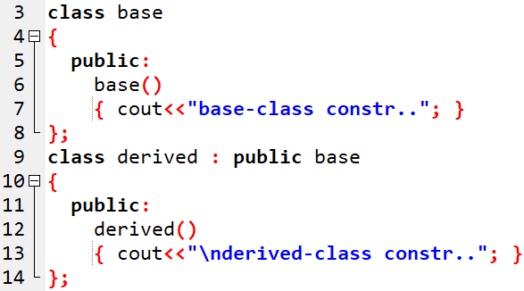
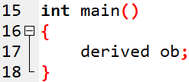

Inheritance & Constructors
Notes:
When both deri and base class contain constructors, base constructor is exe first , then deri class is exe.

Slide 24
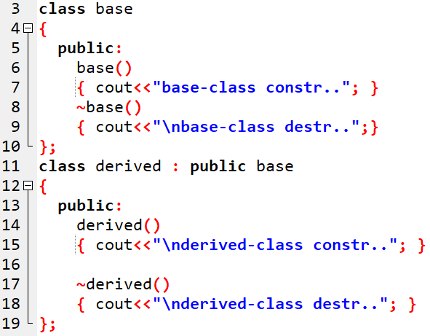
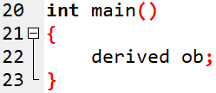

Inheritance with Constructors & Destructor

Slide 25
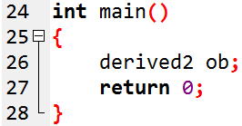
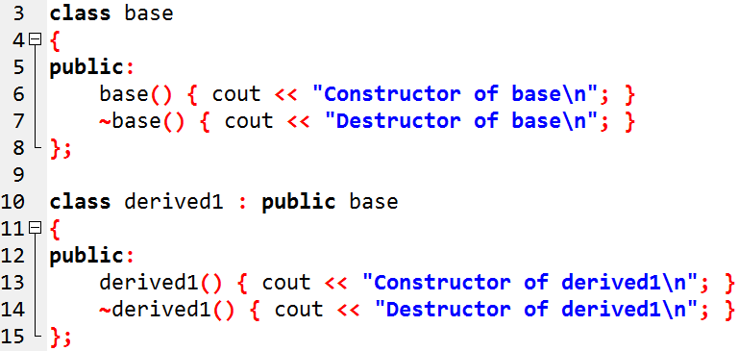
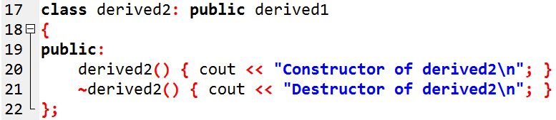
Question-1:

Slide 26

OUTPUT:

Slide 27
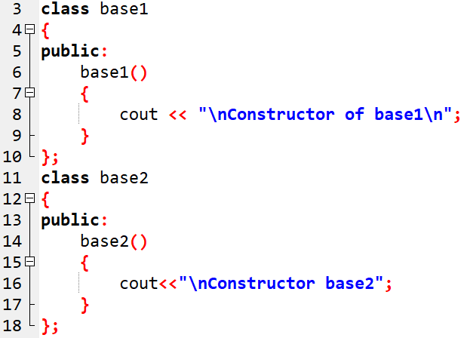
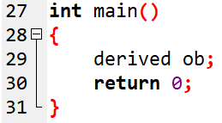

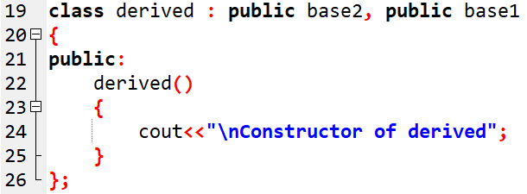
Question-2:

Slide 28
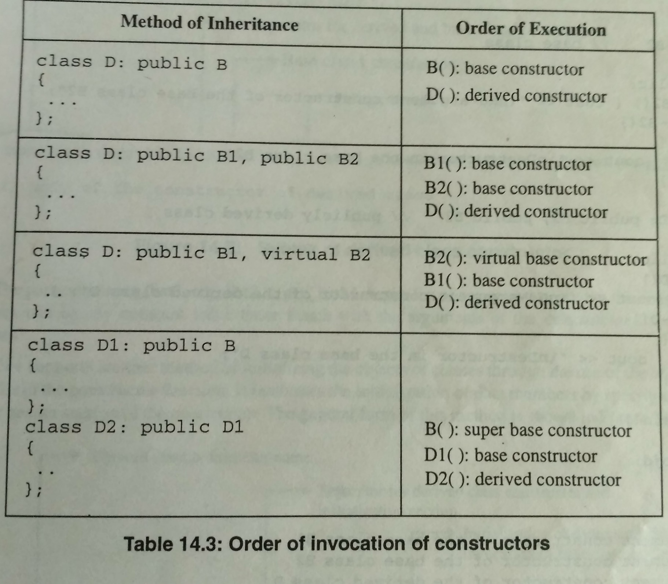

Slide 29
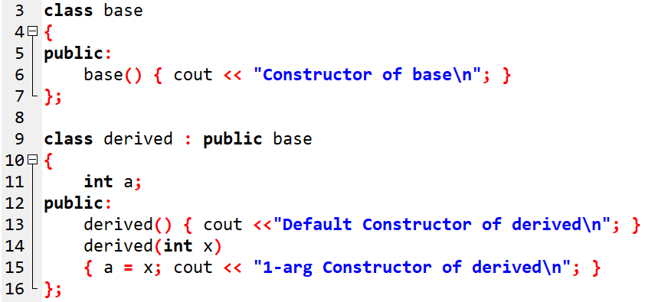
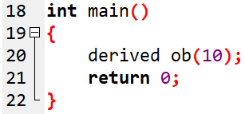

Question 1
OUTPUT:
Notes:
Default constructor in base class is compulsory for parameterized constructor to invoke.

Slide 30
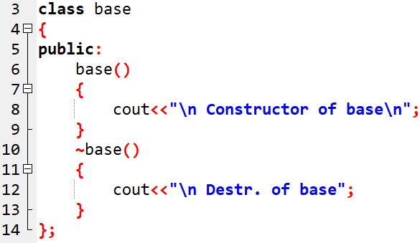
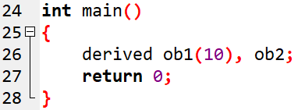
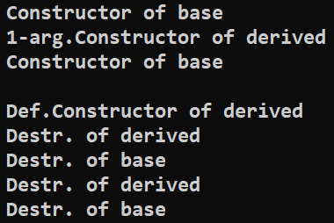

Question 2
Notes:
Constructor is not inherited to child class, only class members are inherited. No need to check the type of inheritance.

Slide 31
OUTPUT:

Slide 32
Passing Parameters to Base-Class Constructors
class base2
{
public:
base2( args )
{
. . .
}
};
class base3
{
public:
base3( args )
{
. . .
}
};
class base1
{
public:
base1( args )
{
. . .
}
};
Derived_constr(arg_list) : base1 ( arglist ), base2 ( arglist ), base3 ( arglist )
{
// body of derived constructor
}

Slide 33
class B {
int x;
public:
B(int a) {
x = a; cout << "1-arg constr in baseB\n";
}};
class D : public B {
public:
D(int a) : B(a) {
cout << "1-arg constr in D\n";
}};
int main() {
D objD(5);
return 0;
}
OUTPUT:
1-arg constr in baseB
1-arg constr in D
No default constructor in the base class, so error generates,,
error can overcome by explicit invocation of a constructor of the base class
Notes:
If base class don’t have default constructor, and has an argument constructor compiler generates error. error can overcome by explicit invocation of a constructor of the base class

Slide 34



Example: passing parameters to base-class constructor
Notes:
Explicitly

Slide 35
Overriding Member Functions

Slide 36




Slide 37




Slide 38




Slide 39



call to show() is ambiguous !!!

Slide 40


Slide 41


Question

Slide 42


Slide 43



Slide 44

Function overriding: Stack Example

Slide 45



Slide 46


OUTPUT

Slide 47

Multiple inheritance

Slide 48


Slide 49



Slide 50



Slide 51



Slide 52



Slide 53




Slide 54


Output

Slide 55

Class Hierarchies

Slide 56



Slide 57


Slide 58

class laborer : public employee //laborer class
{
};

Slide 59



Slide 60


Slide 61
Virtual Base Class
A
memberA
we can prevent multiple copies of the base class by declaring the base class as virtual when it is being inherited.
B
memberA
C
memberA
D
memberA
Multiple copies of member A

Slide 62
Virtual base class (Cont…)
Virtual base class is used to prevent the duplication/ambiguity.
In hybrid inheritance child class has two direct parents which themselves have a common base class.
So, the child class inherits the grandparent via two separate paths. it is also called as indirect parent class.
All the public and protected member of grandparent are inherited twice into child.
We can stop this duplication by making base class virtual.

Slide 63
class A
{
protected:
int i;
};
class B: virtual public A
{
protected:
int j;
};
class C: public virtual A
{
protected:
int k;
};
class D:public B, public C
{
int sum;
public:
D(int v1,int v2,int v3)
{ i=v1;j=v2;k=v3; }
void show()
{ sum = i + j + k;
cout<<sum;
}
};
int main()
{
  D ob(10,20,30);
  ob.show();
}

Slide 64
VIRTUAL BASE CLASS
STUDENT
INTERNAL_EXAM
EXTERNAL_EXAM
RESULT

